Slide 1
Create High-Fidelity Designs and Prototypes

Slide 2
Topics
Build mockups and high-fidelity prototypes
Define and apply common visual design elements and principles.
Demonstrate how design systems can be used to organize, standardize, and enhance designs.
Understand the role of design critique sessions and feedback while iterating on designs.
Learn how to hand off finished design projects to engineering teams.
Complete mobile app designs to include in a professional UX portfolio
Notes:
Objective
Create a mockup
Refine mockups by adding emphasis, hierarchy, and scale and proportion
Understand how to use a design system
Participate in a critique session and iterate on designs based on that feedback
Create a high-fidelity prototype
Iterate on your high-fidelity prototype based on feedback from a usability study
Build case studies to showcase your

Slide 3
Visual Design
Visual design is “How a product or technology appears to users”.
Visual design aims to improve a design’s aesthetic appeal and usability with suitable images, typography, space, layout and color.
It’s deal with the look and feel of a product. The goal is to create an interface that provides users with the optimal experience.
Include elements and principles to transform low-fidelity wireframe to high-fidelity designs

Slide 4
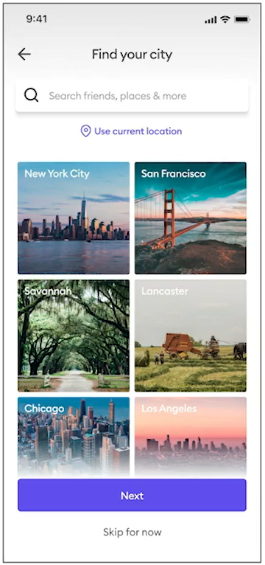
What is Mockup?
Mockup: a static, high-fidelity design that is used as a representation of a final product.
Mockup is an indication of what the product will look like visually.
Different between the mockups and wireframes:
In a wireframe, there are only featured empty spaces, or placeholders, for content
In a mockup, there are actual photos, use of color, use of shadows, different fonts, and stylized buttons.

Slide 5
Build Mockup
To create mockups, we'll use visual design elements and layouts.
Elements like typography, color, and iconography are the building blocks for visual design.
Elements are often arranged into layouts using methods like grids, containment, and space.
The way you arrange elements on a screen can make your design aesthetically pleasing, help users interact with your product, and make your designs more accessible

Slide 6
Foundational elements of visual design
Typography: refers to the use of text and fonts. Can help add hierarchy to your designs, make text easy to read, and add visual style.
Color: messages that certain colors communicate, how people understand color, and how colors mix, match, or contrast with one another. The color wheel in art class, it helps us find colors that are harmonious or complementary.
Iconography: refers to the images or symbols associated with a subject or idea.
Other elements like size, shape, and direction

Slide 7
Typography in UX
Typography refers to the use of text and font.
Three steps to find the perfect typography for your design:
Selecting a type classification,
Picking a typeface,
Choosing a font

Slide 8
Typography – Type classification
Type classification is a general system to describe styles of type.
Two of the most popular type classifications are Serif and Sans Serif.

Slide 9
Typography – Typeface
A typeface is the overall style of a letter. Typefaces are distinguished by their stroke weight, shape, type of serif, and line lengths.
Each typeface is known by a family name.
Examples

Slide 10
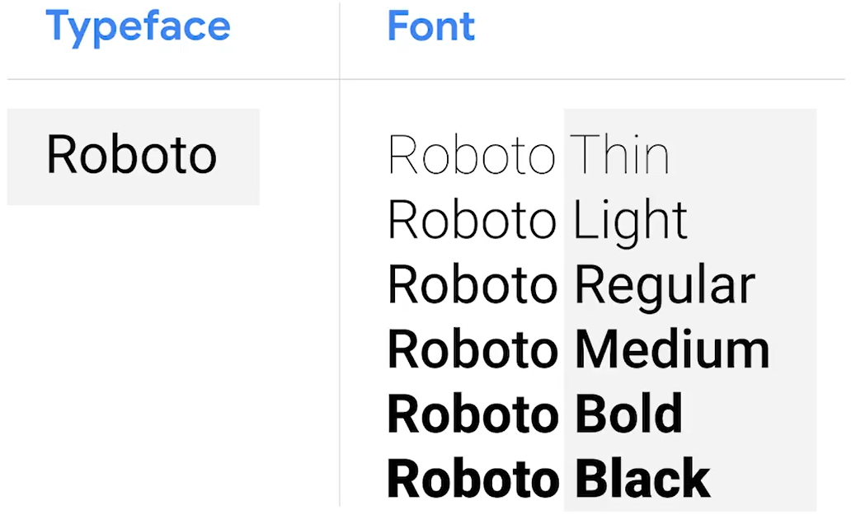
Typography – Font
Font is the size, thickness, and emphasis of letters.
The difference between typeface and font
Example: The typeface is Roboto. The font can be more light, bold, italicized or regular, and even more variations

Slide 11
The important of typography
Adding hierarchy
To help readers better navigate the page
Legibility
making text easy to read
Matches brand guidelines

Slide 12

Typographic adds hierarchy
A typographic hierarchy is a method of ordering typefaces and fonts in a layout to create divisions that show users where to focus and how to find information.
2 common ways to create typographic hierarchy are by changing the typeface's size and weight.
Example:
The font of the title, headline is usually larger in size and bolder in weight than the other words on the page
A bold typeface gives more emphasis or importance to the text

Slide 13
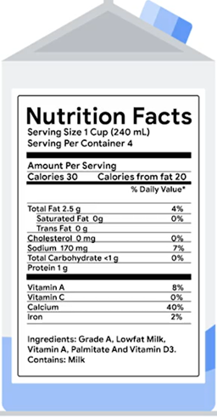
Typography makes text easy to read
Example
Food labels are usually printed in bold black text on a white background. Helps all grocery shoppers easily identify and read nutritional information about the food.
Checkout section of an ecommerce website, designers choose typography that is bold and easy to read so that the user is sure that they're paying correctly

Slide 14
Typography matches brand guidelines
Brand guidelines are visual style choices used to communicate a brand's identity, values, and mission.
Brand guidelines have rules on typography and other visual design elements that have already been researched, tested, and approved by the company's design team.
For example,
Google uses a sans serif typeface called Google Sans. The typeface is seen in all of our marketing material and in the Google logo. This reinforces the Google brand.

Slide 15

Color in UX
Colors can affect behavior, mood, and thoughts
Colors can convey emotions, signal actions, and add variety.
For example,
Red, attracts a lot of attention.
Blue can communicate serenity and feelings of calmness or peace

Slide 16
The importance of color in UX design
Add emphasis
Communicate branding
Impact the accessibility of designs.

Slide 17
Color in UX design: Add emphasis
A change in color can draw the attention of users to a focal point in your design. That is an important action you want users to take, like a sign-up link or a purchase button. ==> Make that point a bright color.
One common rule can use is the 60-30-10 rule.
A neutral color makes up 60% of the color palette in your design to support backgrounds, lines, and text.
A complementary color makes up 30% of the palette.
A accent color makes up 10% of the palette to add emphasis or highlight information
Example: we might use white as 60% of the color in the design, gray as 30%, and orange as 10%.

Slide 18



Communicate branding of color
Communicate branding is the visual appearance and voice of a company.
Colors play an important role in a company's brand guidelines. Helps define a product’s visual identity, making it stand out among competitors.
Example:
some of the most globally recognized brands and the colors they feature in their products and logos.

Slide 19
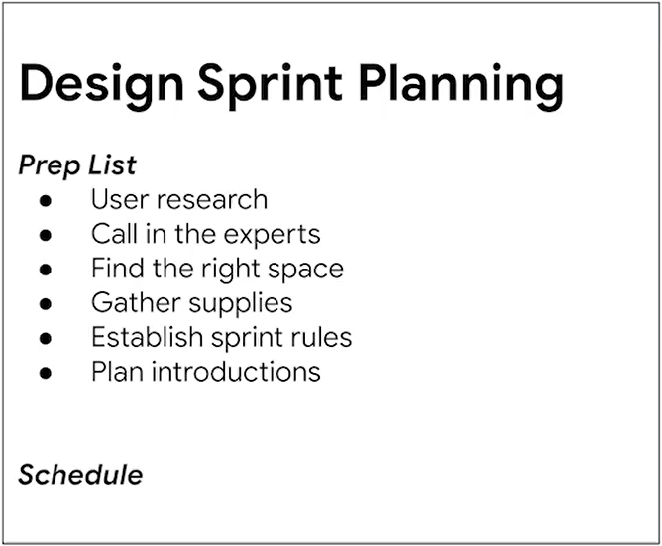
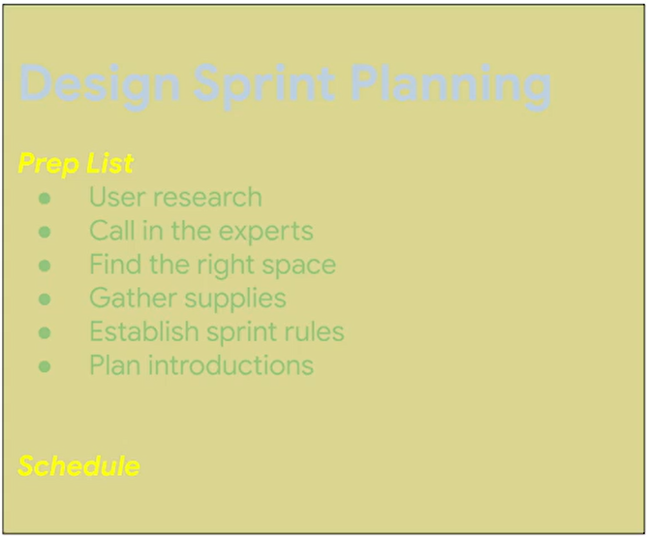
Color impact the accessibility
It's important to check the contrast between the colors you choose. For example:
As a designer, you should follow Web Content Accessibility Guidelines, or WCAG, on color contrast standards to make sure your designs are accessible

Slide 20
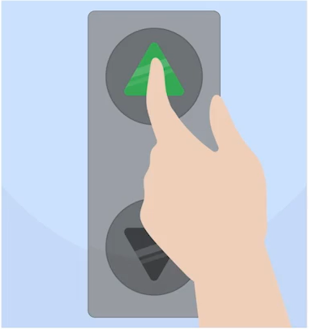
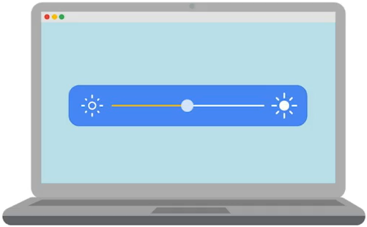
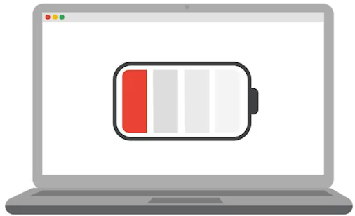
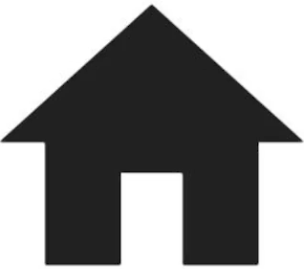
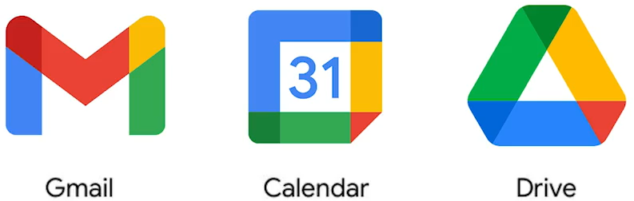
Iconography
A system of graphic images or symbols that are associated with a subject or an idea, called icons.
Icons limit wasted tech space, catch the user's attention, is an easy way to transition to another page or location.
We rely on icons to give us information in both digital and physical environments
Iconography is crucial to a company's brand.

Slide 21
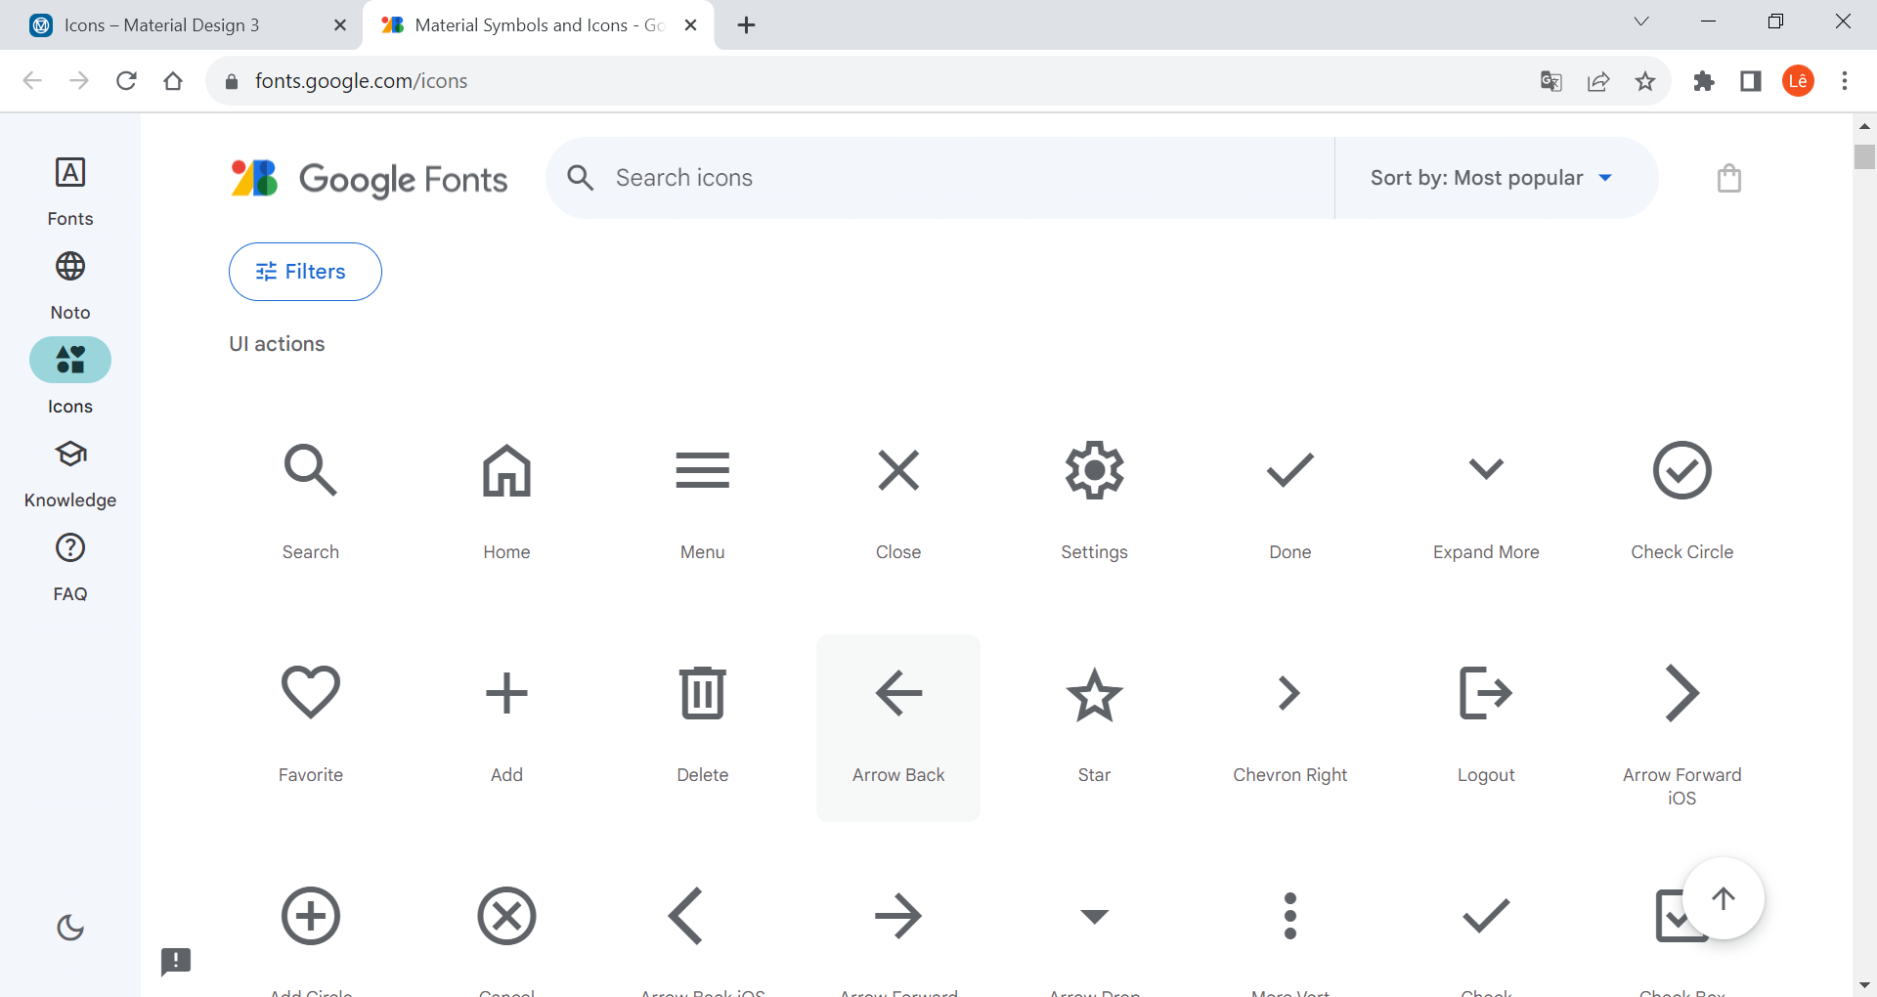
Google's Material Design
a list of free icons that are available for anyone to use

Slide 22
Add image to mockup designs
Why should include images in mock-ups?
Images can help communicate a message without using words.
Create an emotional response from users.
An app or website have a set of strong images throughout can create a connection to the product in a way that supports the content.
Set a product apart from the competition.

Slide 23
Layout
Ways to arrange elements on a page. Layouts usually refer to the specific placement of text, style, icons, and images.
The goal is to present information in a logical way, making the important elements stand out
Without a thoughtful layout, your designs will be difficult for users to interact with.
Layouts can easily be reused from other projects with similar pages.
For example, there are popular layouts for home screens, login screens, and even checkout screens

Slide 24
Using grids to guide layouts
The correct placement of elements on the design can improve user flow and make it easier to navigate
Basic grids. Intersecting lines divide pages into small squares that allow you to easily layout elements in a design.

Slide 25
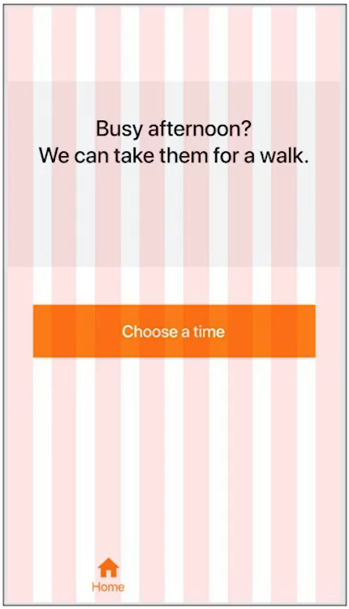
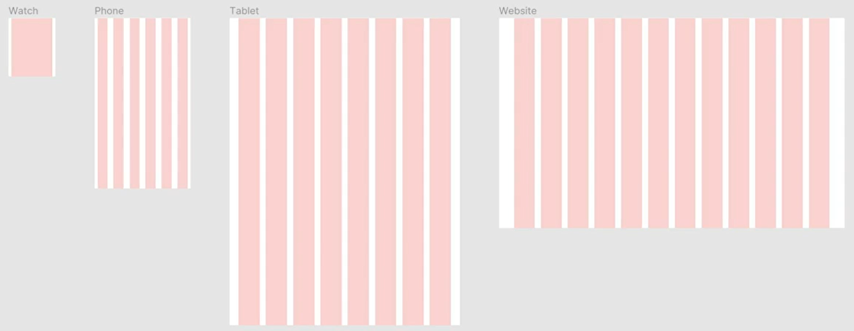
Using grids to guide layouts
A layout grid is a series of columns and alleys (spaces) that allow you to organize elements in a design
The number of columns in a layout grid depends on the type of device you're designing for

Slide 26
Reasons to use grid
Create clarity and consistency.
An effective grid guides the eye, making it easier and more pleasant to scan elements on the screen.
Quicken the design process, making it faster to place elements on the screen.
Make it easier to collaborate on designs.
Try using a grid to plan this design

Slide 27
Use containment in layouts
Containment uses visual barriers to keep designs neat and organized.
Barriers like lines or colors help limit content to a specific section of a design.
There are four methods of containment: dividers, borders, fill, and shadow.

Slide 28
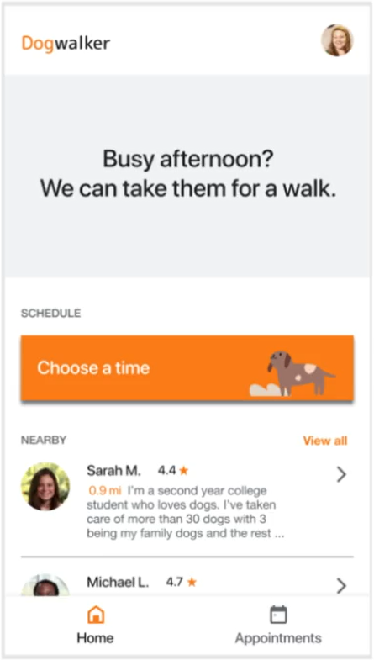
Methods of containment
Dividers are lines that separate sections
Borders use lines to break up sections of a page.
Fill assigns colors to borders and shapes.
Shadows create dimension in combination with borders or fill.
Border, fill and shadow
Dividers

Slide 29
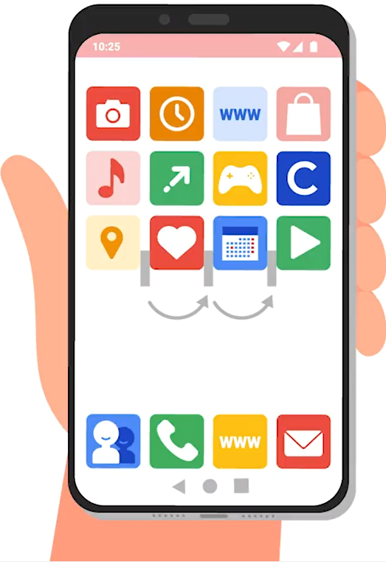
Use negative (white) space in layouts
This is a proximity principle in action
White space is the gaps between elements in a design.
Why is white space important?
Provide emphasis on a focal point within the design.
Group items together, which is also known as proximity

Slide 30
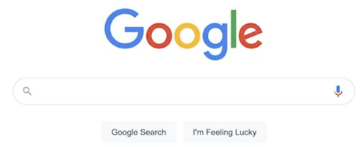
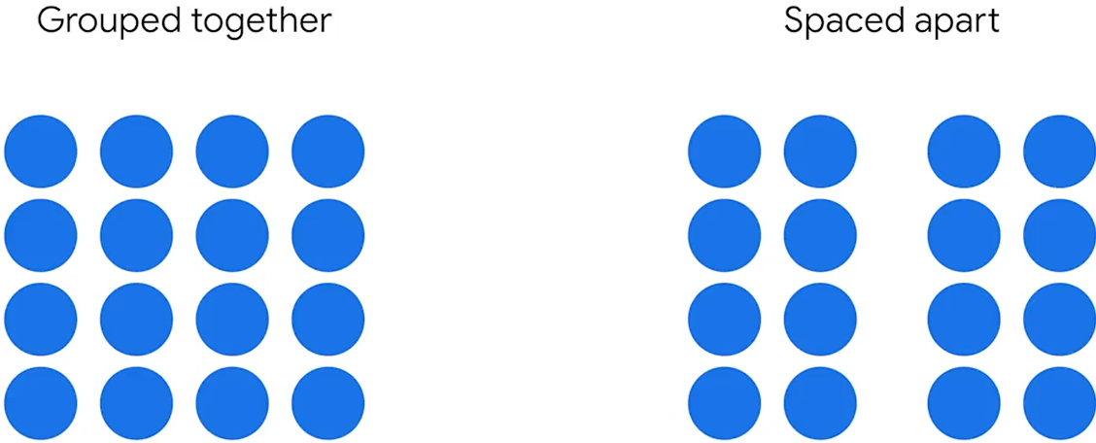
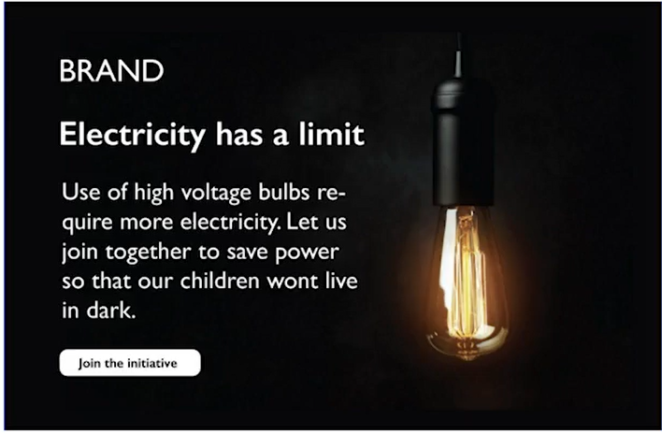
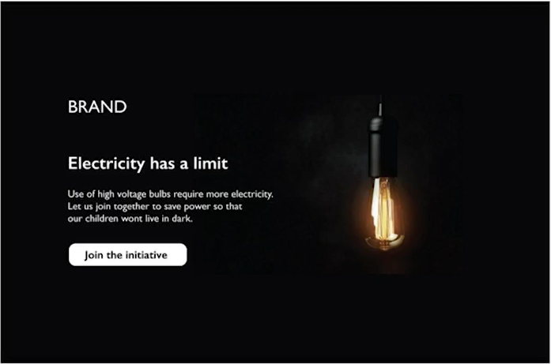
Why is white space important?
Provide emphasis on a focal point within the design.
Group items together, which is also known as proximity
Help with readability

Slide 31
Applying visual design principles
Emphasis
Hierarchy
Scale and proportion
Gestalt Principles:
Similarity, Proximity, Common region
Closure, Continuation, and Symmetry

Slide 32
Emphasis in UX design
Something that attracts attention
We use emphasis to intentionally guide a user to what we want them to pay attention to
To emphasize one part of your design over another, give it more visual weight.
Visual weight is a measure of the force that an element exerts to attract the eye.
Using variables like size, color, or contrast, can give an element greater visual weight.

Slide 33
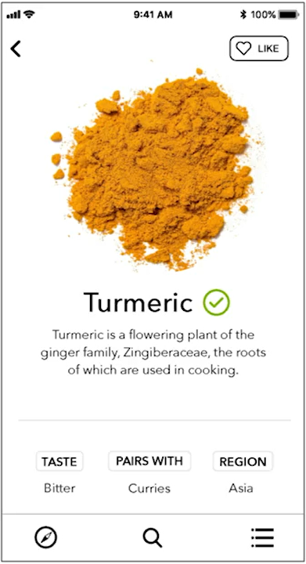
Mockup example with emphasis
By using white space and a simple typeface, users are naturally attracted to the app's main content: its images of spices

Slide 34
Deciding what to emphasize
Where do I want to draw the user's attention?
What are the user's goals?
Using emphasis strategically can make it easier for your users to complete tasks, and that creates a great user experience.
It should be easy for users to find any action or important information they need to complete a task

Slide 35
Hierarchy in UX design
Hierarchy is a visual design principle that orders elements on a page and highlights them by their importance.
The goal of hierarchy is to guide the user.
Adjusting size and color is a common way to distinguish hierarchy in visual design.
Hierarchy in UX design can help the user understand the relative importance between different elements

Slide 36
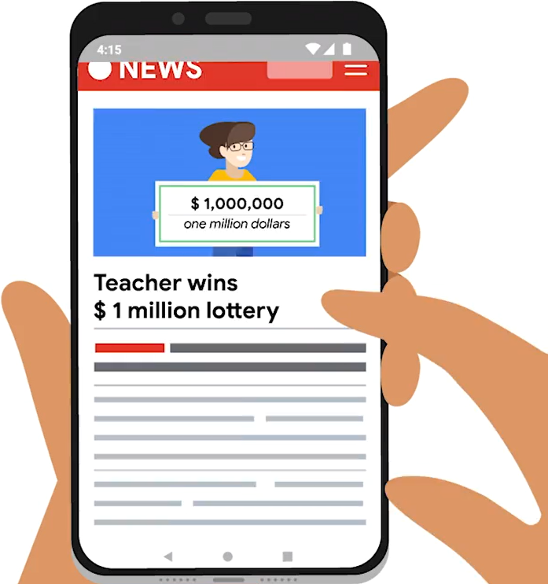
How hierarchy is different from emphasis
Hierarchy refers to a group of elements that are organized in order of importance.
Emphasis is about making one element stand out from the other elements surrounding it.
Example:
On the news site, most people usually check out the headlines first, right?
The headlines are the elements that stand out on the page. Below it is the story summary, usually in a smaller and less bold font

Slide 37
Why do we need hierarchy
We always want to make it clear to the user
Where to focus first
What action to take.
More important information => more visually prominent.
Helps point users to the first step they should take in their user journey.
find the most relevant information and main action buttons first.
guides the user to the most important places on the page.
Notes:
Helps point users to the first step they should take in their user journey.
We apply hierarchy when we create mockups to help users navigate an app effortlessly.
Hierarchy helps them find the most relevant information and main action buttons first.
Hierarchy also guides the user to the most important places on the page.

Slide 38
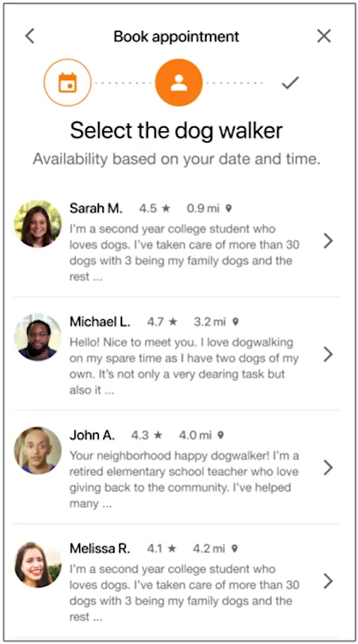
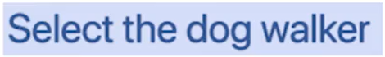
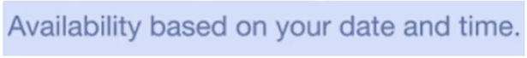
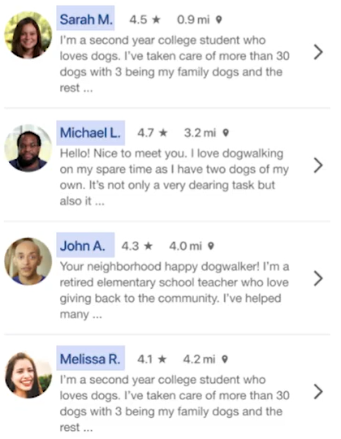
Apply hierarchy to Dog Walker app
The second step of booking an appointment.
The text, "Select the dog walker" is at the top of the page with larger text.
Most of the content underneath it will contain information about this process
The next text, "Availability based ony our date and time" is smaller than “Select the dog walker", but larger than the details about each dog walker.
All of the dog walkers listed are available at the date and time they selected.
The names of each dog walker are in a darker gray color than the associated text
Should focus on the name of the dog walker first and then look at the other details.
Notes:
This page is part of the second step of booking an appointment.
Under the three icons indicating the steps for booking an appointment, there's the text,"Select the dog walker." Ordering this text at the top of the page indicates that most of the content underneath it will contain information about this process. Sizing the text larger makes that point even clearer.
As we move down the page, there's the next line of text, "Availability based on your date and time." This text is smaller than"select the dog walker," but larger than the details about each dog walker. It's important for the user to recognize that all of the dog walkers listed are available at the date and time they selected.
Also, notice that the names of each dog walker are in a darker gray color than the rest of the text associated with that dog walker. Remember, hierarchy highlights elements on the page by their importance. This subtle design choice indicates to the user that they should focus on the name of the dog walker first and then look at the other details. This is similar to the technique used in the headline examplewe discussed earlier.

Slide 39
Scale and proportion in UX design
Scale
Explain the size relationship between a given element and the other elements in the design.
The most important elements in a design are bigger than the less important elements.
Notes:
Scale is a concept that's used to explain the size relationship between a given element and the other elements in the design. The most important elements in a design are bigger than the less important elements.

Slide 40
The important of scale
Creating emphasis.
Use scale to make that element larger than the other elements around it.
Show similarity and contrast between elements.
Two same size elements are perceived equal or similar. However, if two elements have a large contrast in size, perceived different from one another.
Communicate visual hierarchy.
For example, typography could be easily changed using scale to emphasize the content on a page in different ways.
Notes:
Scale is a concept that's used to explain the size relationship between a given element and the other elements in the design. The most important elements in a design are bigger than the less important elements.
So why is scale important for UX design? Well there are a few reasons.
First, manipulating the size or scale of a single element, like a button, is a great technique for creating emphasis. To emphasize an element, you can use scale to make that element larger than the other elements around it. Think of how using a magnifying glass can instantly enlarge your view of an object. In the same way, creating variation in size of certain elements in your design can help you highlight specific areas.
In addition, scale can show similarity and contrast between elements. If two elements are the same size, they are perceived as being equal or similar. However, if two elements have a large contrast in size, they're perceived as being different from one another.
Lastly, scale can be used to communicate visual hierarchy. Earlier you learned how hierarchy is used to communicate the order of importance for the information on a page. Scale helps to create visual hierarchy. For example, typography could be easily changed using scale to emphasize the content on a page in different ways. This image shows how different type scales can be used to create headlines

Slide 41
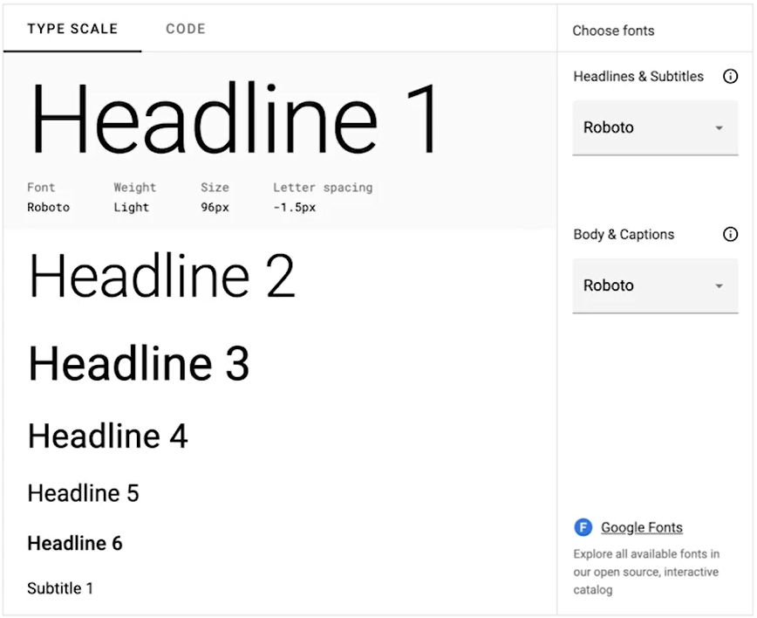
Scale communicate visual hierarchy
Scale by typography:
how different type scales can be used to create headlines

Slide 42
Proportion in UX design
Proportion
The balance or harmony between elements that are scaled.
Make sure the size relationship between elements makes sense ➔ The elements appear to be in balance with one another.
If one element in your design increases in size, then the other elements should also increase in size at the same rate in order to remain proportionate
Notes:
Proportion is about the balance orharmony between elements that are scaled. In other words, proportion helps UX designers make sure the size relationship between elements makes sense. This means that the elements appear to be in balance with one another. If one element in your design increases in size, then the other elements should also increase in size at the same ratein order to remain proportionate

Slide 43
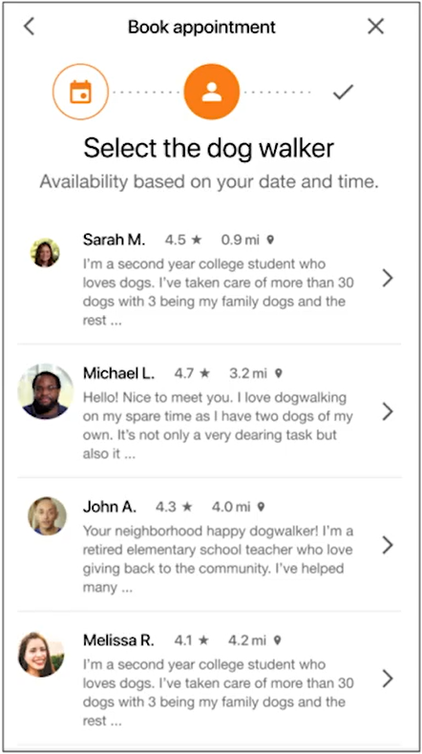
Proportion example
The images of the four dog walkers are the same scale.
There is harmony between these elements.
If we change the scale of the images, they quickly fall out of proportion

Slide 44
Unity and variety in UX design
Unity measures how well elements of your design work together to communicate an idea.
Pleasing to look at, clear to the user, and easy to understand.
Unity can be created by using a consistent color scheme, complementary fonts, and consistent spacing
Variety, varying the elements in your design to break up monotony.
Add energy and pizzaz to a design.
To incorporate variety in designs, can using different shapes, colors, textures, and patterns
Notes:
Unity measures how well elements of your design work together to communicate an idea.
A design with unity is pleasing to look at, clear to the user, and easy to understand. Unity can be created by using a consistent color scheme, complementary fonts, and consistent spacing. On the other end of the spectrum is variety, which is about varying the elements in your design to break up monotony. Using diverse elements can add energy and pizzaz to a design. There are countless ways to incorporate variety in your designs, like using different shapes, colors, textures, and patterns. Do you have any walls in your house that are painted an accent color? Or have you ever paired brightly colored shoeswith a plain outfit? If so you probably understand how variety can help breakup predictable patterns. During the beginning stages of your low-fidelity wireframes, creating unity or variety is not the focus. When you create your lo-fi wireframes, your buttons and graphics are usually just black-and-white placeholders.
During this stage, you'remore concerned about how features function together and less about their appearance. When you eventually getto designing mockups, you can focus onthe whole picture. Ask yourself questions like, Did I use colors in aconsistent and purposeful way? Did the typefaces I usedwork well together? And is there enough variety to keep my design interesting? Keep in mind that neither unity nor varietyare good or bad. There are parts of yourdesign that require one or the other -- or even both. Variety can be used strategically to add visual weightand create emphasis.

Slide 45
Unify & variety in design mockups
Did I use colors in a consistent and purposeful way?
Did the typefaces I used work well together?
And is there enough variety to keep my design interesting?
Neither unity nor variety are good or bad.
There are parts of your design that require one or the other -- or even both.
Variety can be used strategically to add visual weight and create emphasis
Notes:
When you eventually get to designing mockups, you can focus on the whole picture.
Ask yourself questions like,
Did I use colors in a consistent and purposeful way?
Did the typefaces I used work well together?
And is there enough variety to keep my design interesting?
Keep in mind that neither unity nor variety are good or bad. There are parts of your design that require one or the other -- or even both. Variety can be used strategically to add visual weight and create emphasis

Slide 46
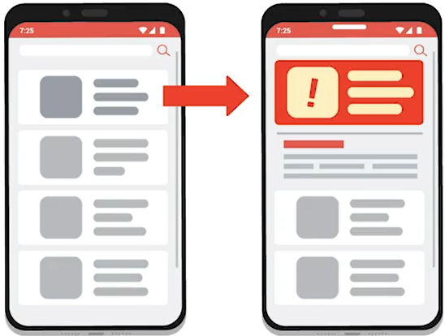
Unify and variaty Example
Media outlet apps have unified designs.
Most stories will use dark text on a white background.
Now if there was a breaking news report about the weather. The breaking news story background might turn a bright color like red or yello
Notes:
an app for a news outlet. The most effective media outlet apps have unified designs. Most stories will use dark text on a white background. Now imagine if there was a breaking news report about the weather. The breaking news story background might turn a bright color like red or yellow. Adding this variety to the notification helps break the consistency and lends more urgency to the story. These elements of variety help the breaking story stand out, but they only work because the styles of the other stories are unified

Slide 47
Balance of variety and unity
Variety and unity can work together in harmony.
Too much uniformity can make it difficult for users to know where to focus.
Too much similar typography or iconography, users can find it hard to identify important information
Variety in texture, color, typography, and shape can can add emphasis or divert their attention.
But, too much variety can reduce harmony and make it harder to read important info.
The key is balance:
A balanced combination of unity and variety can provide visual cues for users while maintaining their attention.
Notes:
But variety doesn't have to take away from unity. In fact, variety and unity can work together in harmony.
Too much uniformity can make it difficult for users to know where to focus. With too much similar typography or iconography, users can find it hard to identify texts and important information from a sea of identical design elements.
A balanced combination of unity and variety can provide visual cues for users while maintaining their attention. You want to make sure it's visually gratifying to use a product too.
Variety in texture, color, typography, and shape can make all the difference. This variety can add emphasis to guide users to press a button or divert their attention to a section of the page. But be careful: Too much variety can reduce harmony and make it harder to read important info. The key is balance

Slide 48
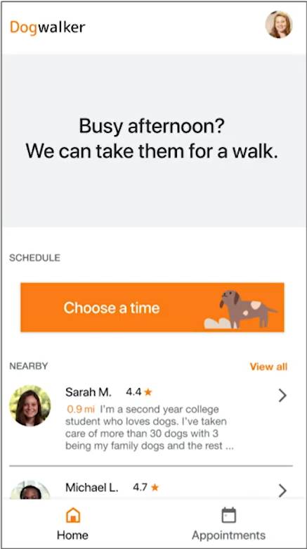
Apply unify & variaty in Dog walker
The mockup of the homepage
There is a consistent orange color scheme and even spacing between elements.
This unity makes the homepagepleasing to look at, and easy to understand.
Most of the design is white or light gray, but the "choose a time“ button is orange.
This variety in color adds emphasis that guides the user to press this button

Slide 49
Apply Gestalt Principles to mockups
Notes:
Gestalt principles describe how humans group similar elements, recognize patterns, and simplify complex images whenwe perceive objects. In other words, the human brain will attempt tosimplify and organize complex images by subconsciously arranging the partsinto a cohesive whole. Basically, your brainis wired to see structure, logic, and patterns. Gestalt principles helpus better understand how all the individual designchoices we've been making come together and how they mightbe interpreted by users. Gestalt principles alsooffer designers a way to step back and review their work from a different perspective. It's easy for designersto get so caught up in the details that we losesight of the overall project. Applying Gestalt principlesto our designs allows us to really notice how our design elementswork together. Similar to how we can use multiple visual designprinciples to create emphasis, several Gestalt principlescan be applied to one mockup design at the same time tomake visual connections. In this video, we'll cover three of the Gestalt principles: similarity, proximity,and common region. It's important tonote that there are a lot of Gestalt principles, including closure,continuation, and symmetry. We'll only coversimilarity, proximity, and common region inthis video though, because they give thebroadest overview for how Gestalt theory isused in UX design. Okay! Let's definethese principles and explore how they apply to design. We'll start with similarity. The principle of similaritystates that elements that look similar are perceived to havethe same function. In other words, similarityfocuses on things that look or behave the same way and how the user willrelate those items. Let's examine howour dog walker app uses the principle of similarity. Here, you'll notice that we use orange to symbolize actions. The dog walker tab acrossthe top of the screen, the selected dogwalker check mark, and the Next button are allactions the user can select, and they all use the same color. Even if we go to anew page of the app, the color orangestill continues to point users to the actionthey need to take. This is an example of how color is used togroup what we see. Your brain automaticallygroups these orange elements. Because they are the same color, they are perceived tohave the same function. Another example of thesimilarity principle in action is how every circle on this page representsa user profile. All of the circles have the same visual weight on the page. Whether the user has aprofile picture like Sarah M., or uses a first initiallike Alice or Sal, your brain automaticallymakes the connection that these similar shapesrepresent the same idea: a user profile. You'll instantly make this connection when you see other circles of thissize in the app. Next, let's explorethe principle of proximity, whichstates that elements that are close togetherappear to be more related than elements thatare spaced farther apart. In other words, humans perceive objects close toeach other as connected. The way sighted peopleand screen readers read is an example of the proximityprinciple in action. The lack of space betweenletters or characters tells you that those lettersor characters form a word. The space between and afterthose groups of letters or characters let you know thata new word has started. The principle of proximity is also used in our dog walker app. When a user is scheduling an appointment with a dog walker, the app providesa horizontal list of the names of the user's pets: Charlie, Broccoli, and Rover. The user selects whichdogs need a walk. The closeness of these buttons lets you know thatthey're related. The closeness of the listof dogs to the question, "Who is going for a walk?" lets you know thatthe question is related to this list of dogs. On the other hand, thisquestion and list of dogs is far away from therecurring booking box. The space between these elements indicates that theyare not related. Okay! One more Gestaltprinciple to cover. Finally, there's theprinciple of common region, which states thatelements located within the same area are perceivedto be grouped together. Although it's connected tothe principle of proximity, the principle of common region differs because ithas less to do with spacing elementsapart and more to do with using visual elementsto form sections. Here we have a mockupof an app created by a UX designer atGoogle named Kaiwei. The app is called Rostery. It was created to helpcollege professors remember their students' faces andnames in a fun and simple way. On this screen, the app isbroken into three sections: the navigation bar at the top, the memorization progress graph, and the names of the students the professor wants to remember. Each of these sections contains multiple elements, likegraphics, photos, and text. Using the principleof common region, your eye automatically groups the content that's inthe same area together. In this example, Kaiwei added a border aroundeach group of elements, which is an easy way tocreate a common region. Let's also check outthe principle of common region inthe dog walker app. I used a blue background behind our selected content tocreate a common region. The user is able toquickly identify the items on a blue background asthe selected dog walker, and the content onthe white background as unselected items. The key takeaway from Gestalt principles isthat we should make sure that our designswork with the way our minds naturallyorganize elements. When used thoughtfully,Gestalt principles can help create visual balance. Visual balance is thesense that a design is equally weighted on both sidesof its emphasized center. Visual balance gives the design a feeling of completeness. You can learn more aboutvisual balance in the reading. That's it for now. You'restarting to think like a real UX designer and can apply these Gestalt principles toyour own mockups. Good luck.

